Slide 1
Bell Work
Grab A Computer,
Get Logged In,
Navigate to Brickalyer.org,
Sign into Teams

Slide 2
Math analysis
Day 8

Slide 3
Objective
Saving in Bricklayer-Lite
Uploading in Bricklayer-Lite
Downloading from Teams and Uploading
Recreate Objects in Bricklayer-Lite

Slide 4
Saving in Bricklayer Lite to Teams
Change “Filename” make sure it ends with .xml
Click Download XML
Open up Teams
Open the appropriate folder: 3_Saving In Bricklayer-Lite
Click “upload” and select your recently downloaded file
Save
*Move the file to your Own Drive from your Downloads folder

Slide 5
Uploading in Bricklayer-Lite from Teams
Open up Teams
Open the appropriate folder: 3_Saving In Bricklayer-Lite
Click “download” in the … option on the file you wish to work with
Open up Bricklayer-Lite
Click “Choose File” and pick the file you just downloaded
If you make changes, save in the same manner as stated on the previous slide

Slide 6
Bricklayer-Lite
Using Bricklayer-Lite code, recreate the following objects
Save your code, and upload them into the appropriate folder:
4_Objects In Bricklayer-Lite

Slide 7
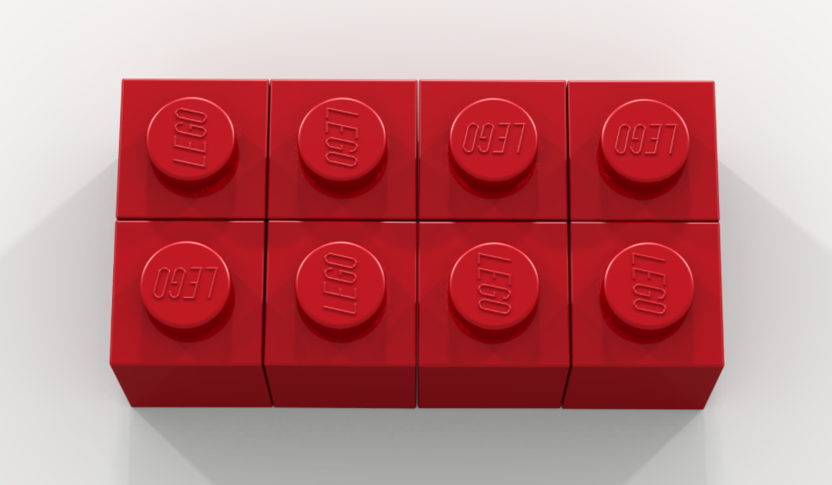

Slide 8
